Slide 1

Module 1
Overview of the Data Mining Process
Notes:
Guidelines
Use section headers to chunk content in your presentation.
Use the same style of section header throughout your presentation.
Keep your title to no more than 2 lines.

Slide 2

Example: Choose, fit, evaluate models
Notes:
Guidelines
Use a title slide at the beginning of your presentation. There are 9 variations of title slides to choose from.
If you will have a series of slideshows, we recommend using the same style of title slide for each presentation.
Keep your title to no more than 2 lines.
Do not change the font style or font size of the title or subtitle.

Slide 3
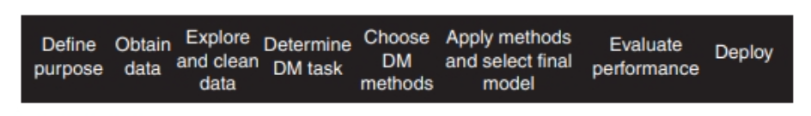
Data Mining Process
We have gone over
Define purpose
Obtain data
Explore and clean the data

Slide 4
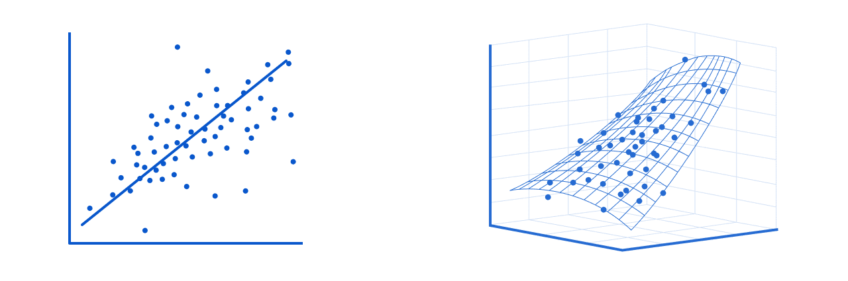
STEP 4: Determine Data Mining Task
We wish to predict median_house_value
This is numeric variable: regression task
What method can we use?

Slide 5
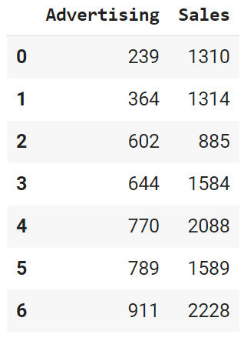
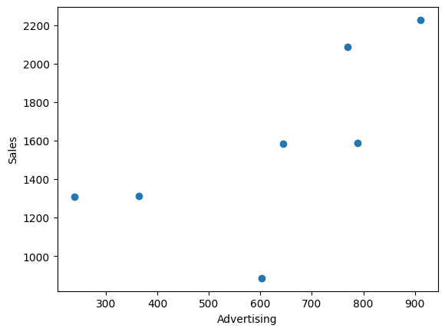
Overfitting Considerations
Careful with overfitting
TRUE y_intercept: 300
TRUE slope: 2

Slide 6
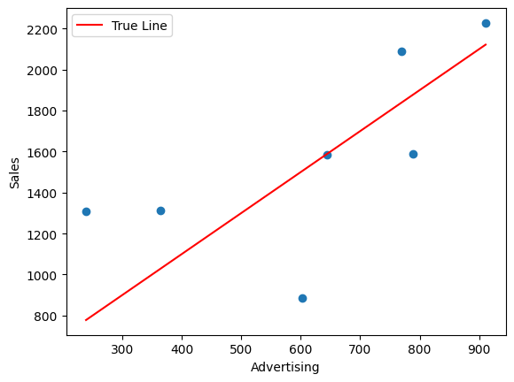
Overfitting Considerations
Careful with overfitting
TRUE y_intercept: 300
TRUE slope: 2

Slide 7
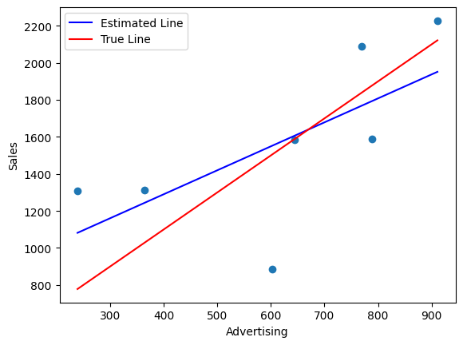
Overfitting Considerations
Careful with overfitting
TRUE y_intercept: 300
TRUE slope: 2
Estimated y_intercept: 772.21
Estimated slope: 1.29

Slide 8
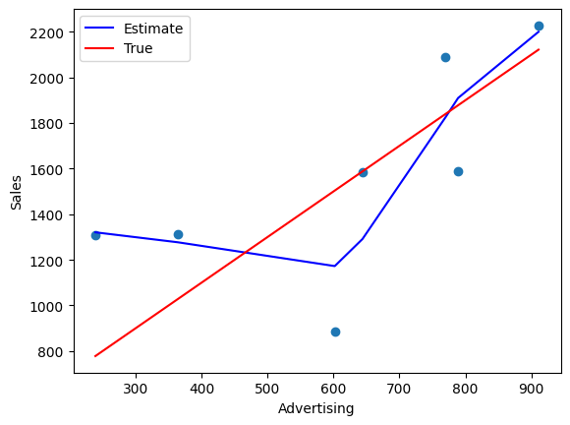
Overfitting Considerations
Careful with overfitting
TRUE y_intercept: 300
TRUE slope: 2
4th Order Polynomial

Slide 9
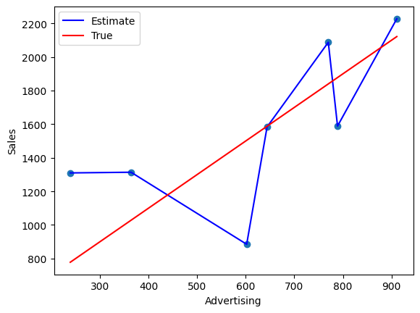
Overfitting Considerations
Careful with overfitting
TRUE y_intercept: 300
TRUE slope: 2
Random Forest

Slide 10
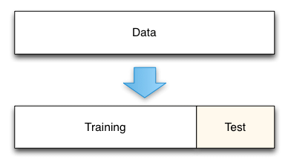
Train/Test Split
We partition the data to avoid choosing a model that overfits.

Slide 11
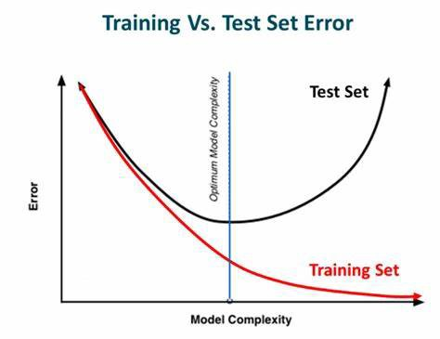
Train/Test Split
Select model that performs best in Test Set

Slide 12
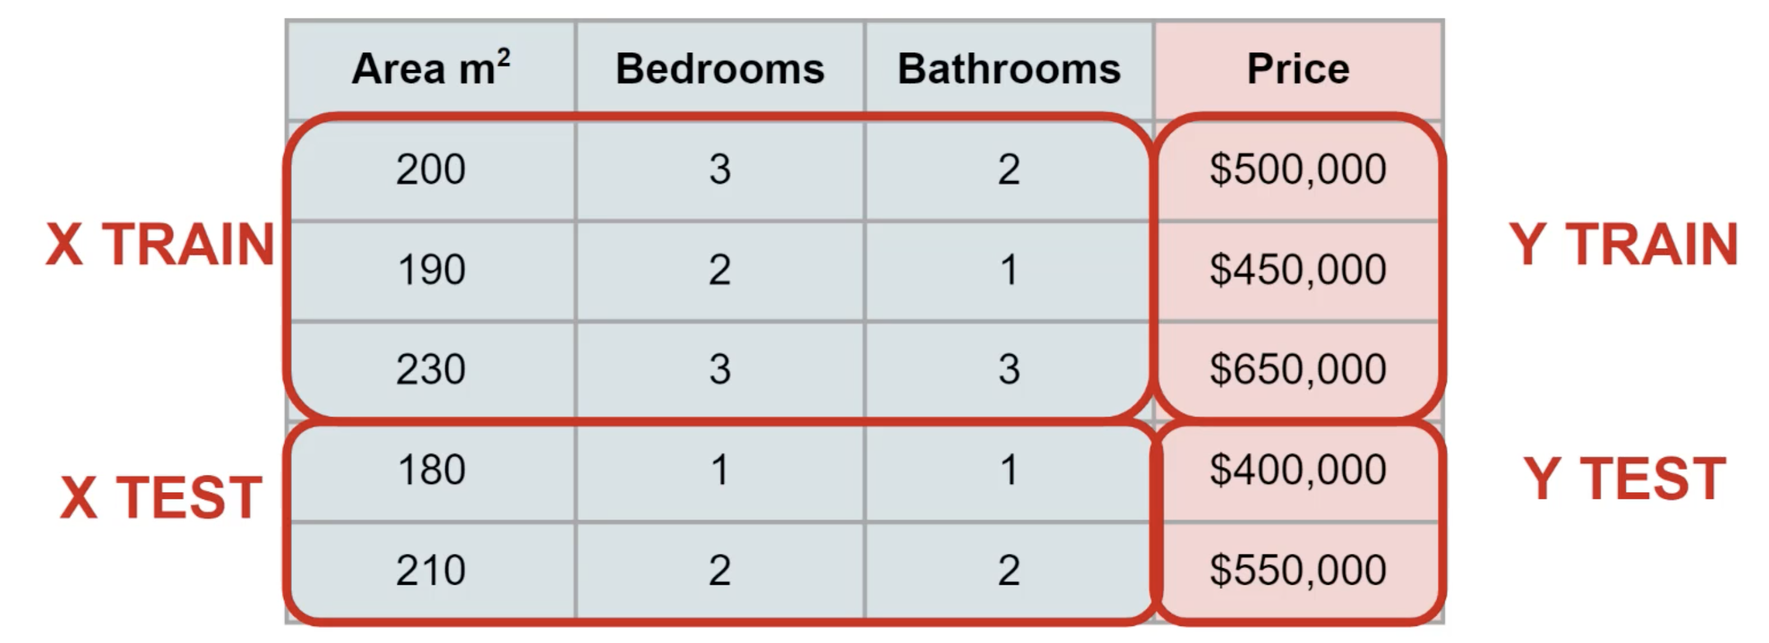
Train/Test Split
Training
features
Test
features
Training
Target
Test
Target

Slide 13
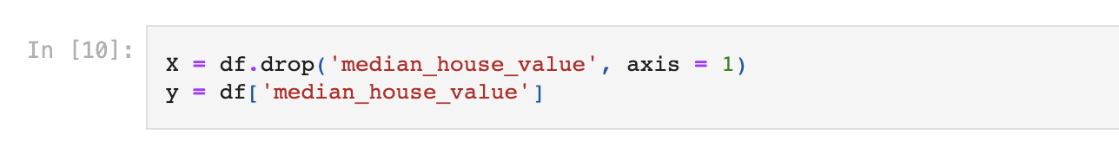
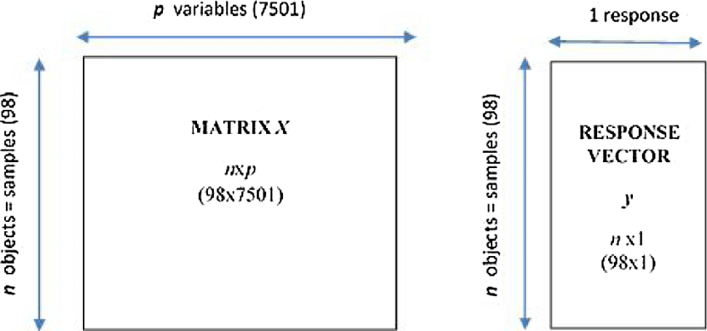
Train/Test Split

Slide 14
Python
Notes:
Guidelines
Use a title slide at the beginning of your presentation. There are 9 variations of title slides to choose from.
If you will have a series of slideshows, we recommend using the same style of title slide for each presentation.
Keep your title to no more than 2 lines.
Do not change the font style or font size of the title or subtitle.

Slide 15
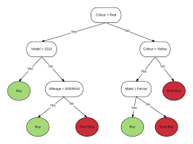
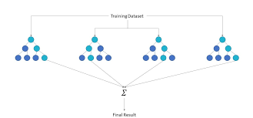
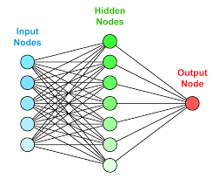
STEP 5: Fit Models
Linear Regression
Decision Tree Regressor
Random Forest Regressor
Boosting Regressor
Neural Networks

Slide 16
Python
Notes:
Guidelines
Use a title slide at the beginning of your presentation. There are 9 variations of title slides to choose from.
If you will have a series of slideshows, we recommend using the same style of title slide for each presentation.
Keep your title to no more than 2 lines.
Do not change the font style or font size of the title or subtitle.

Slide 17
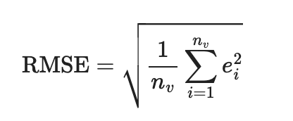
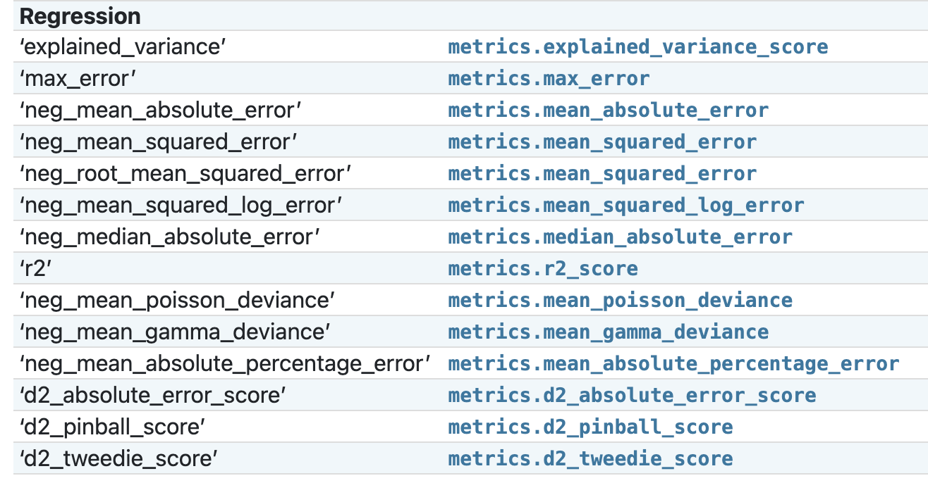
STEP 6: Evaluate Performance
Metrics depend on task
Mean squared error (MSE)
Root mean squared error (RMSE)
R²

Slide 18
Python
Notes:
Guidelines
Use a title slide at the beginning of your presentation. There are 9 variations of title slides to choose from.
If you will have a series of slideshows, we recommend using the same style of title slide for each presentation.
Keep your title to no more than 2 lines.
Do not change the font style or font size of the title or subtitle.

Slide 19
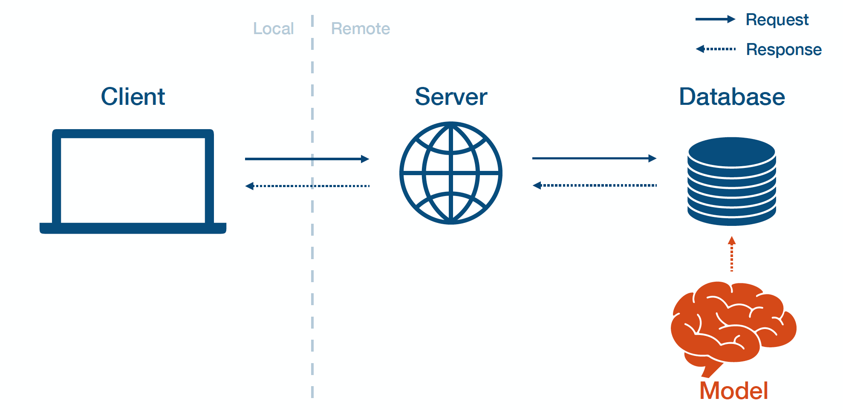
STEP 8: Deploy Models
Save the champion model
Pre-Trained Model

Slide 20
Python
Notes:
Guidelines
Use a title slide at the beginning of your presentation. There are 9 variations of title slides to choose from.
If you will have a series of slideshows, we recommend using the same style of title slide for each presentation.
Keep your title to no more than 2 lines.
Do not change the font style or font size of the title or subtitle.

